Slide 1
The International Collaboration for Transfusion Medicine Guidelines (ICTMG) has created this slide deck to support knowledge mobilization of this guideline.
We encourage the use of this deck by health-care professionals for education or training purposes.
Kindly use the material under the following conditions:
  Cite the ICTMG as a reference.
  Use the ICTMG logo on slides in your presentation.
  Do not modify the ICTMG statement of recommendations.
  Do not modify the slide content.
Notes:
Notes for presenter.

Slide 2
Hemolytic disease of the newborn (HDN)
IVIG in the management of Rh- and ABO-mediated HDN
Slides prepared August 2023
Notes:
(Read slide)

Slide 3
Disclaimer & disclosures
The ICTMG guidelines should be used in the context of applicable medical, legal and ethical requirements in any individual case.
ICTMG receives funding from Canadian Blood Services. Canadian Blood Services does not influence the content of the guidelines.
Presenter disclosures
(*presenter to insert COI’s here, if applicable)
Notes:
Note for presenter: insert relevant disclosures prior to presentation, if applicable.
(Read slide).

Slide 4
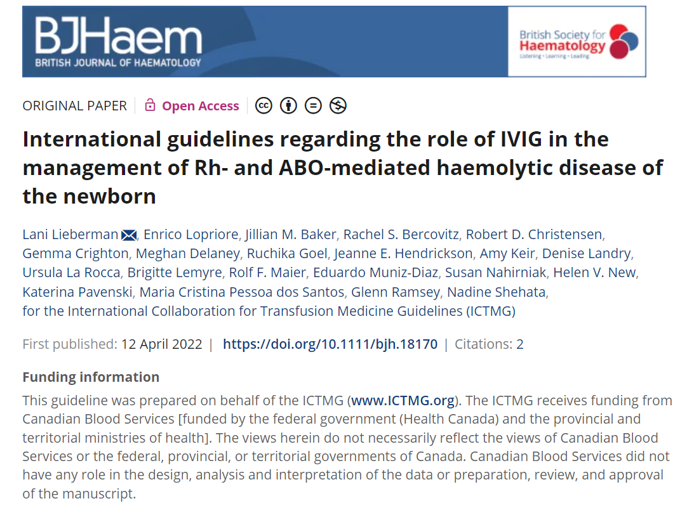
The ICTMG's HDN guideline
Notes:
As an independent collaborative of volunteers with expertise in transfusion medicine and related clinical disciplines, guideline development methodology and implementation research, the ICTMG's mission is to optimize patient outcomes through evidence-based international transfusion guidance development and relevant local implementation.
In April 2022, the ICTMG's guideline on HDN was published in the British Journal of Haematology (https://doi.org/10.1111/bjh.18170). The guideline is available as an open access publication.

Slide 5
What is HDN?
Hemolytic disease of the newborn (HDN) is a blood disorder occurring in 3-80/10,000 neonates per year.^{1,2}
HDN occurs when maternal IgG antibodies reactive to paternal blood group antigens traverse the placenta, causing immune-mediated hemolysis of fetal red blood cells.³
HDN may also be known as:
Hemolytic disease of the fetus and newborn (HDFN)
Erythroblastosis fetalis
Notes:
Hemolytic disease of the newborn (HDN) is a blood disorder that occurs due to differences in blood type between mother and baby.
Two lay-language pamphlets– one focused on ABO incompatibility and one on Rh disease and other non-ABO antibodies– are available on ICTMG.org to provide additional information about HDN to patients and families. Health-care professionals are encouraged to share these pamphlets amongst their networks and with the patients and families.

Slide 6
Why did ICTMG develop an HDN guideline?
Approaches to treatment may vary with main treatment options being:
  Intensive phototherapy (PT),
  Exchange transfusions (ET), or
  Intravenous immunoglobulin (IVIG).
Both ET and IVIG treatments carry risks to the patient. ​
This guideline provides evidence-based recommendations on the effectiveness and safety of IVIG, in addition to intensive PT, in newborns with Rh- or ABO-mediated HDN.
Notes:
Severe cases of hemolytic disease of the newborn (HDN) can be associated with significant infant morbidity, neurocognitive defects, and mortality.
In addition to intensive phototherapy (PT), treatment options may include exchange transfusions (ET) or intravenous immunoglobulin (IVIG). Both ET and IVIG treatments carry risks to the patient.
The ICTMG's guideline provides evidence-based recommendations on the effectiveness and safety of IVIG, in addition to intensive PT, in newborns with Rh- or ABO-mediated HDN. This guideline also emphasizes the urgent need for additional studies to assess the optimal use of IVIG for patients with HDN.

Slide 7
Who is this guideline intended for?
This guideline is intended primarily to inform:
  Neonatologists
  Hematologists, Pediatric hematologists
  Gynecologists
  Emergency physicians
This guideline may also help to inform:
  Midwives
  Medical trainees
  Patients, Families
  Researchers
Notes:
(Read slide)

Slide 8
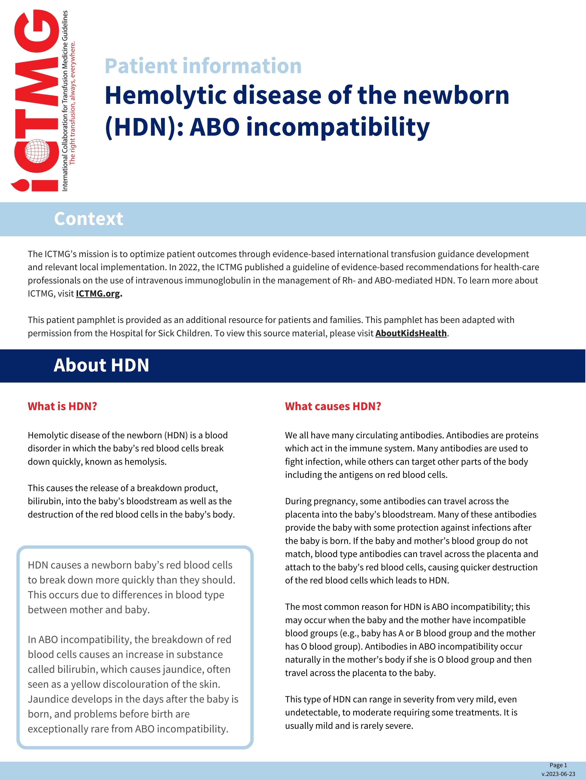
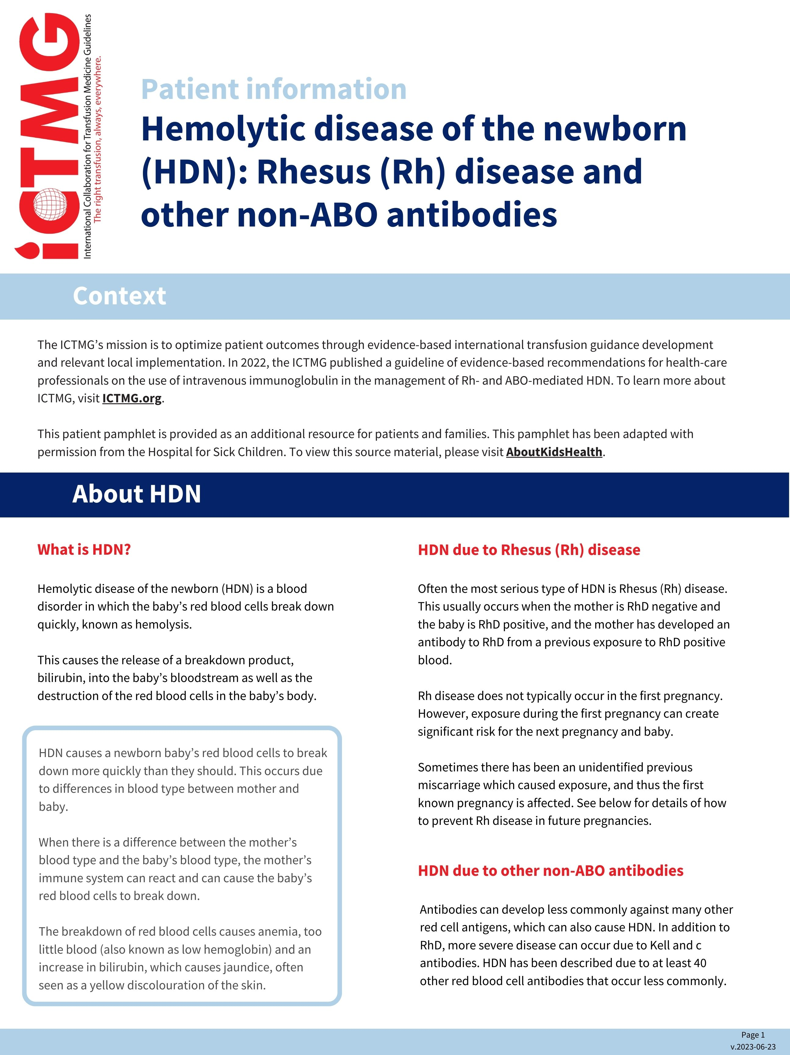
What additional resources are available?
Two lay-language pamphlets for patients and families are available on ICTMG.org.
Translations include:
  French
  Spanish
  German
  Italian
  Portuguese.
These pamphlets have been adapted with permission from the Hospital for Sick Children. To view this source material, please visit AboutKidsHealth.ca.
Notes:
Two lay-language pamphlets– one focused on ABO incompatibility and one on Rh disease and other non-ABO antibodies– are available on ICTMG.org to provide additional information about HDN to patients and families. Health-care professionals are encouraged to share these pamphlets amongst their networks and with the patients and families.

Slide 9
HDN guideline methodology
The ICTMG follows internationally accepted practices and methods for the development of its clinical guidelines.

Slide 10
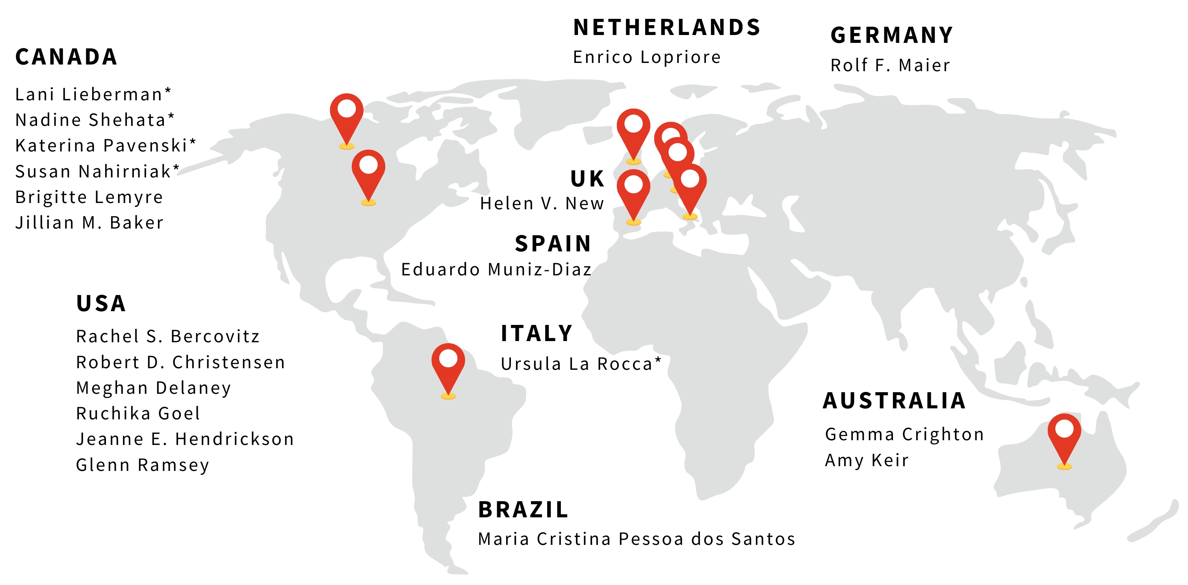
HDN Guideline Development Group (GDG)
The international panel of expert volunteers for this HDN guideline included:
* denotes ICTMG full membership at the time of guideline development
Notes:
The guideline development group for this guideline included the following group of international experts as authors (listed on slide). Authors of the HDN guideline have no financial or intellectual conflicts of interest to declare. The ICTMG receives funding from Canadian Blood Services; Canadian Blood Services does not influence the content of the guidelines.
ICTMG full members at the time of publication included:
Lani Lieberman (Canada)
Nadine Shehata (Canada)
Katerina Pavenski (Canada)
Susan Nahirniak (Canada)
Ursula La Rocca (Italy)
ICTMG project members included:
Jillian M. Baker (Canada)
Brigitte Lemyre (Canada)
Rachel S. Bercovitz (USA)
Gemma Crighton (Australia)
Robert Christensen (USA)
Meghan Delaney (USA)
Ruchika Goel (USA)
Jeanne Hendrickson (USA)
Amy Keir (Australia)
Rolf F. Maier (Germany)
Eduardo Muniz-Diaz (Spain)
Helen V. New (U.K)
Maria Cristina Pessoa dos Santos (Brazil)
Glenn Ramsey (USA)
Enrico Lopriore (Netherlands)

Slide 11
How was this guideline developed?
Generating
evidence
A systematic literature review (registered in PROSPERO) generated evidence on the clinical question
Grading
evidence
Evidence was graded as per the Grading of Recommendations, Assessment, Development and Evaluation (GRADE) tool and presented to the GDG
Developing
recommendations
Reporting of guideline recommendations was guided by Appraisal of Guidelines for Research & Evaluation II (AGREE II)
Notes:
The ICTMG follows internationally accepted practices and methods for the development of its clinical guidelines:
A Systematic Literature Review (registered in PROSPERO-CRD42019142072) was conducted to generate evidence on the clinical question.
Evidence generated from the Systematic review was graded as per the Grading of Recommendations, Assessment, Development, and Evaluation (GRADE) tool.
The graded evidence was presented to the Guideline development group (GDG) to formulate recommendations.
The conduct and reporting of guideline recommendations were guided by Appraisal of Guidelines for Research & Evaluation II (AGREE II).
Software used included: Distiller SR for systematic review management and GRADE pro-GDT software for grading of evidence]

Slide 12
What was the clinical question?
In neonates with hemolytic disease of the newborn (HDN), in addition to phototherapy (PT), does IVIG:
Reduce the need for or frequency of exchange transfusion,
Improve bilirubin level or anemia,
Reduce the frequency of top-up transfusions (number or volume),
Improve neurocognitive outcomes (kernicterus, acute impairment, chronic impairment),
Reduce the length of stay, and/or
Reduce mortality?
Population:
Neonates with HDN
Intervention:
IVIG (in addition to PT)
Notes:
The clinical question for this guideline was: In neonates with Hemolytic Disease of the Newborn (HDN), in addition to phototherapy, does IVIG reduce the need for or frequency of exchange transfusion, improve bilirubin level or anemia, reduce the frequency of top-up transfusions (number or volume), improve neurocognitive outcomes (kernicterus, acute impairment, chronic impairment), reduce the length of stay, and/or reduce mortality?

Slide 13
How were outcomes ranked?
Outcomes were ranked by level of importance using GRADE:
 | Weighted Average | GRADE
Mortality | 8.9 | Critical
Kernicterus | 8.7 | Critical
Acute neurological impairment | 8.3 | Critical
Chronic neurological impairment | 8.5 | Critical
Need for exchange transfusion | 7.3 | Critical
Need to top up transfusion | 6.1 | Important
Bilirubin level | 6.9 | Important
Anemia | 5.7 | Important
Length of hospital stay | 5.7 | Important
Notes:
Outcomes deemed important for formulating recommendations were chosen by the guideline development group using Grading of Recommendations, Assessment, Development and Evaluation (GRADE).
This table outlining the ranking for outcomes used in the guideline is replicated from Appendix 2.

Slide 14
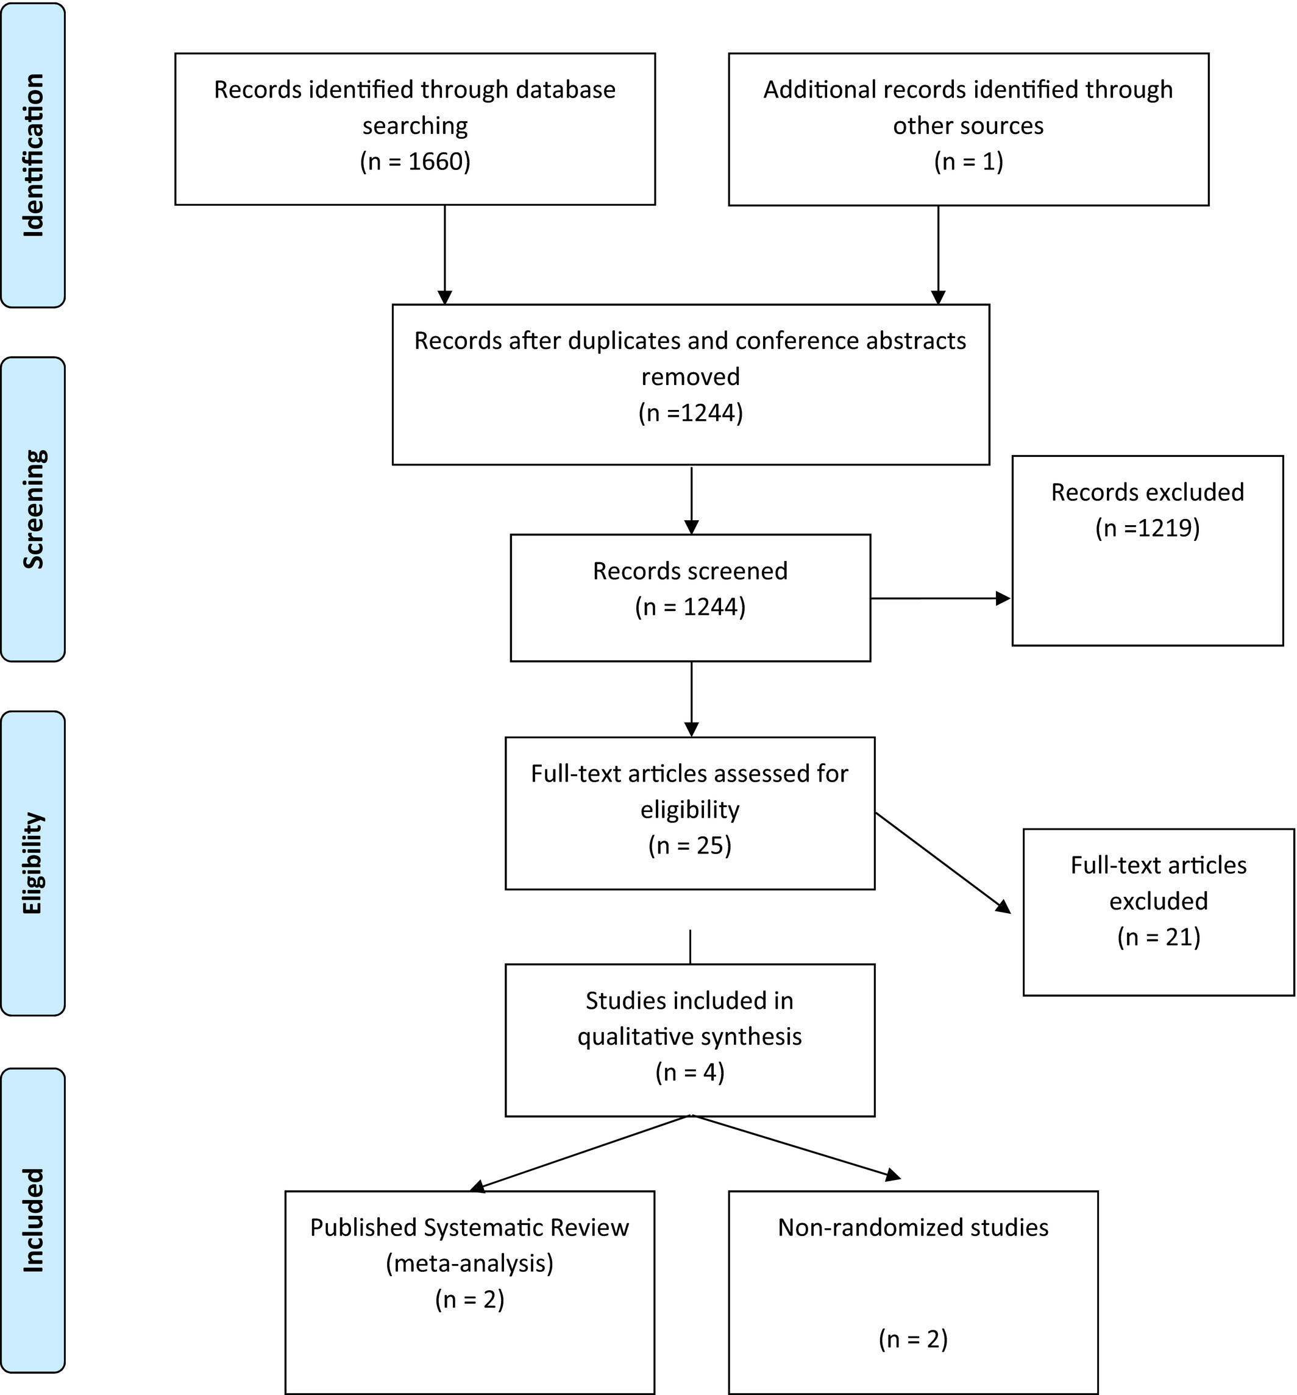
Systematic review
References to assess the use of IVIG for HDN:
1661 total records identified
1219 records excluded after screening
25 full-text articles assessed
A total of 4 studies were included in the qualitative synthesis
Notes:
This figure outlining article inclusion for the systematic review is replicated from the guideline, showing a total of 1661 records were identified through the database searching and other sources; 25 full-text articles were assessed for eligibility after removing duplicates and conference abstracts and screening the remaining records; and four studies were included in the qualitative analysis following assessment for eligibility.

Slide 15
Guideline reviewers
The guideline was reviewed by external and individual reviewers including:
Organizations* | Individuals*
Italian Society of Transfusion Medicine and Immunohematology (SIMTI) | Prakesh kumar Shah
International Society of Blood Transfusion (ISBT) | Michael Narvey
American Society of Hematology (ASH) | James Cummings
American Society of Pediatric Hematology/Oncology (ASPHO)
Association for the Advancement of Blood and Biotherapies (AABB)
* Reviewers were not asked to endorse recommendations
Notes:
Prior to publication, the guideline was reviewed by external reviewers (listed on slide). Reviewers were not asked to endorse the guideline’s recommendations.
This table identifying external and individual reviewers is replicated from Appendix 3.

Slide 16
HDN guideline recommendations
Recommendations are not intended to replace either the physicians' clinical judgement of the specific case or the physicians' personal experience. Final treatment decisions should be made by the treating physician with consideration of current clinical details.

Slide 17
Management of Rh-mediated HDN
In neonates with Rh-mediated HDN, routine IVIG is not recommended to reduce the need for ET.
This recommendation was evaluated as conditional with low certainty of evidence of effects.
Routine refers to prophylactic IVIG use to prevent progression to severe consequences of hyperbilirubinaemia.

Slide 18
Management of ABO-mediated HDN
In neonates at risk of ABO-mediated HDN, routine IVIG is not recommended to reduce the need for ET.
This recommendation was evaluated as conditional with very low certainty of evidence of effects.
Routine refers to prophylactic IVIG use to prevent progression to severe consequences of hyperbilirubinaemia.

Slide 19
Severe hyperbilirubinaemia
In neonates where hyperbilirubinaemia is severe (unresponsive to intensive PT) and requirement for ET is emergent, but not available on site within a timely manner, no evidence-based recommendations regarding the use of IVIG can be made.
Various non-evidence-based treatment suggestions have been described, but none can be endorsed at this time.

Slide 20
Summary of guideline conclusions
Literature was not found to support the routine use of IVIG.
Additional research, including prospective multicentred studies with standardized follow-up frequency and transfusion threshold guidelines is needed.

Slide 21
Contact ICTMG
Examples of clinical decision-making regarding treatment of Rh- and ABO-mediated HDN have been compiled by knowledge mobilization project members to illustrate the application of these guideline recommendations.

Slide 22

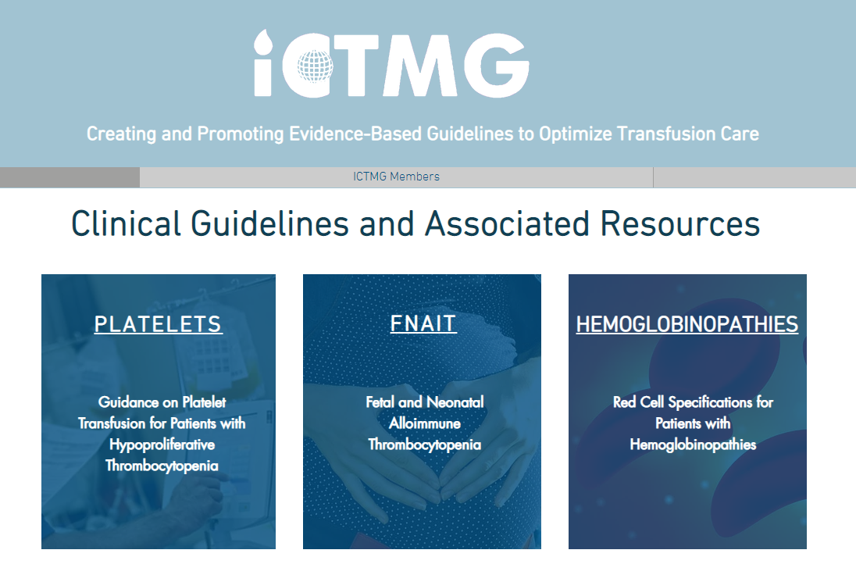
For more information about ICTMG and the HDN guideline:
Visit www.ICTMG.org (or scan this QR-code to access the site)
Email: info@ictmg.org
Notes:
For more information on the HDN guideline and the additional resources for physician and patients, visit www.ICTMG.org or email info@ictmg.org.

Slide 23
References
Webb J, Delaney M. Red blood cell alloimmunization in the pregnant patient. Transfus Med Rev. 2018; 32(4): 213–9.
Lieberman L, Callum J, Cohen R, Cserti-Gazdewich C, Ladhani N, Pendergrast J & Buckstein J. Impact of red blood cell alloimmunization on fetal and neonatal outcomes: a single center cohort study transfusion. Transfusion. 2020; 60(11): 2537–46
Lieberman L, Lopriore E, Baker JM, Bercovitz RS, Christensen RD, Crighton G, et al. International guidelines regarding the role of IVIG in the management of Rh- and ABO-mediated haemolytic disease of the newborn. Br J Haematol. 2022; 198: 183–195. https://doi.org/10.1111/bjh.18170

